Slide 1
Goldfish Foundation
Indoor Venue Feasibility Study

Slide 2
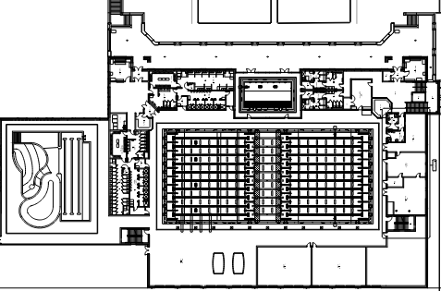
OPTIONS OVERVIEW
Counsilman-Hunsaker developed the following option for consideration that incorporated various types of pools and features to meet the aquatic needs of the residents and attract guests from the surrounding region.
  Indoor Natatorium Spaces
    50-meter pool with two bulkheads
    1- and 3-meter springboard diving
    4,800 sq. ft. community pool
    Two (2) training pools
  Support Spaces
    Admissions
    Offices
    Locker rooms
    Spectator Seating
    Storage
    Pool mechanical
    Family changing rooms
    Food and beverage
Notes:
SAMPLE TEXT SLIDE W/ BULLETS

Slide 3
COST ESTIMATING
Counsilman-Hunsaker has prepared an Opinion of Probable Construction Cost for the pool(s) and building. A budget for site construction costs and furniture fixtures and equipment (FF&E) has also been calculated and included in the estimates. Recent project bid figures of similar projects have been used as well as national estimating guides and local cost adjustment factors.
Notes:
SAMPLE TEXT SLIDE W/ BULLETS

Slide 4
Estimating Process
Cost of building structure
Cost of pools and operational equipment (not separated)
Cost of inside areas all together – not separated
Cost of FFE – estimated not itemized (furnishings/fixtures/equipment)
Cost of soft cost and contingencies = by % of total project
All of the above when added together can give you a STARTING PLACE for cost identification. This process allows the owner to make due-diligence decisions (style and brands) during the design process.

Slide 5
Plus:
Soft Cost
Design 8% to 12%
Permitting 3% to 5%
FFE 20%
Contingency 5% and up
Additional Costs
Land
Utilities to property
Roads & Fences
Exterior Signage
The pool
$285 to $350 psf (specialty pools can be $500+ psf)
The decks & walks
$10-35 psf
The shower rooms –kitchen –staff room
$350 psf (one of the most expensive areas)
Lobby-Offices-Classrooms
$300 psf
Storage - hallways
$200 psf
Brick & mortar
- $275 to $575 psf
Estimating Process

Slide 6
National Construction Cost Comparison
Michigan (101% compared to national average)
  Battle Creek 99%
  Detroit 108%
  Flint 95%
  Grand Rapids 101%
  Grayling 92%
  Jackson 98%
  Lansing 102%
  Marquette 101%
  Pontiac 110%
  Royal Oak 108%
  Saginaw 94%
  Traverse City 99%

Slide 7
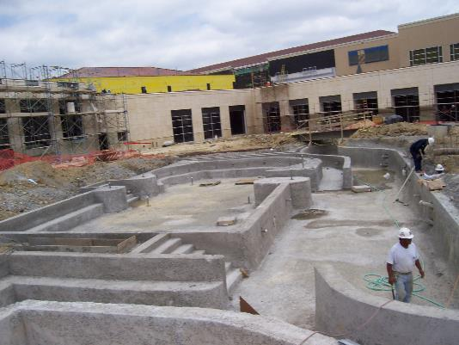
COST IMPACT
NUMBER OF BIDDERS
TIME OF YEAR
MATERIAL COSTS
WEATHER
LOCAL LABOR RATES

Slide 8
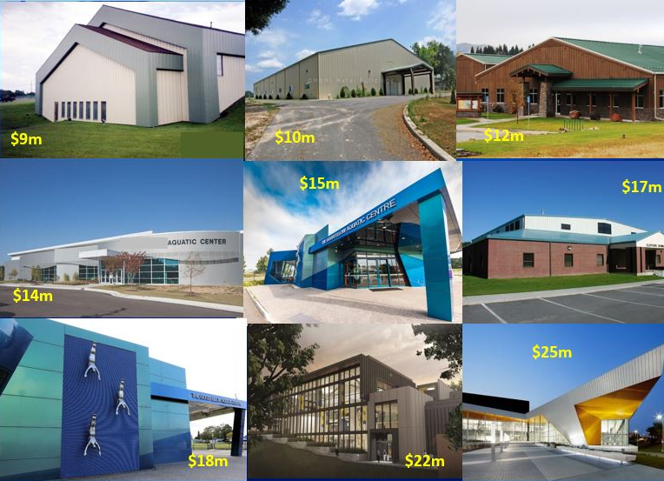
LEVEL OF FINISH – 50-meter pool comparison

Slide 9
Facility Comparison
Facility | Location | Bid Year | Size (Sq.Ft.) | Cost | Cost Per (Sq.Ft.)
Shawnee Mission Aquatic Center | Kansas City, KS | 2018 | 53,000 | $28.0M | $528
Libertyville High School | Chicago, IL | 2018 | 38,000 | $21.5M | $565
Deaconess Aquatic Center (in design) | Evansville, IN | 2019 | 65,000 | $28.0M | $430
Southern Methodist University | Dallas, TX | 2016 | 43,000 | $26.0M | $596
Dulles South Recreation Center | Washington D.C. | 2016 | 81,000 | $42.0M | $523
Northern Arizona University | Scottsdale, AZ | 2015 | 64,500 | $36.0M | $558
Brahan Natatorium | Huntsville, AL | 2016 | 56,400 | $22.4M | $397
Midco Aquatic Center | Sioux Falls, SD | 2015 | 56,000 | $24.0M | $428
Arlington ISD Aquatic Center | Dallas, TX | 2019 | 49,453 | $20.5M | $413
Average $503/Sq.Ft.

Slide 10
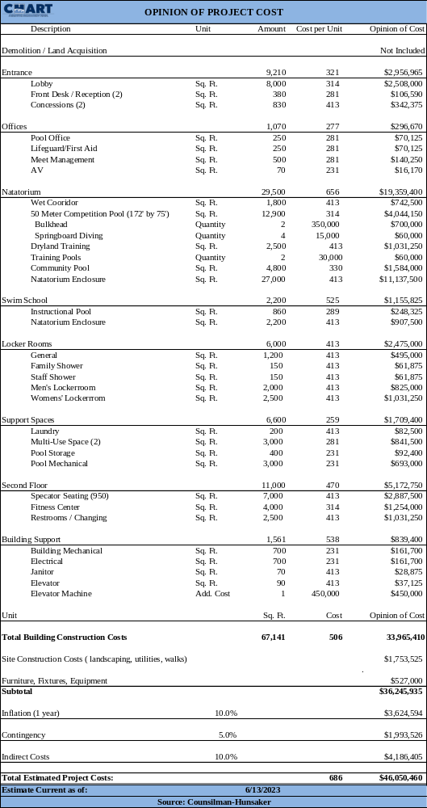
OPTION OVERVIEW
Capital Cost:
  Construction: $33,965,410 ($506 psf)
  Total Project Cost: $46,050,460
Total Size (Acres): 7 to 10 acres
Capacity: 573 (at one time)
Parking: 275 spaces
Features:
  Indoor Natatorium Spaces
    50-meter pool with two bulkheads
    1- and 3-meter springboard diving
    4,800 sq. ft. community pool
    Two (2) training pools
  Support Spaces
    Admissions
    Offices
    Locker rooms
    Spectator Seating
    Storage
    Pool mechanical
    Family changing rooms
    Food and beverage
Notes:
SAMPLE TEXT SLIDE W/ BULLETS

Slide 11
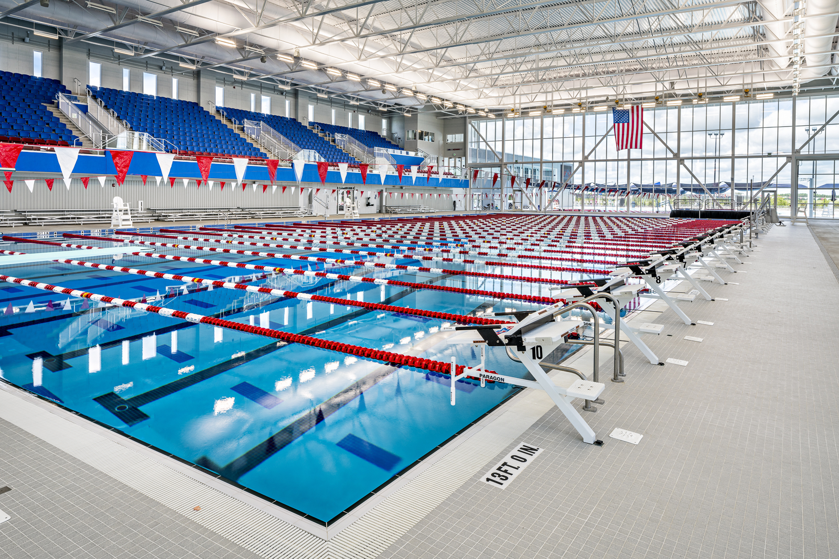
OPTION OVERVIEW
Capital Cost:
  Construction: $33,965,410 ($506 psf)
  Total Project Cost: $46,050,460
Total Size (Acres): 7 to 10 acres
Capacity: 573 (at one time)
Parking: 275 spaces
Features:
  Indoor Natatorium Spaces
    50-meter pool with two bulkheads
    1- and 3-meter springboard diving
    4,800 sq. ft. community pool
    Two (2) training pools
  Support Spaces
    Admissions
    Offices
    Locker rooms
    Spectator Seating
    Storage
    Pool mechanical
    Family changing rooms
    Food and beverage
Notes:
SAMPLE TEXT SLIDE W/ BULLETS

Slide 12
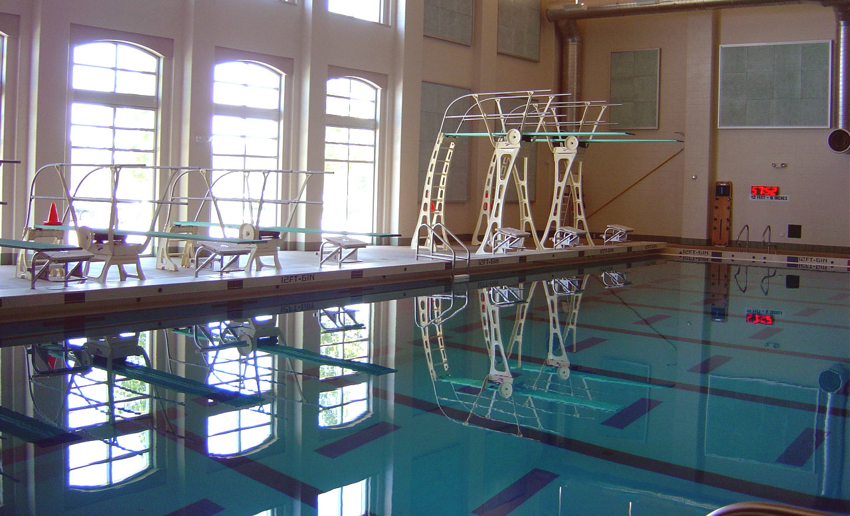
OPTION OVERVIEW
Capital Cost:
  Construction: $33,965,410 ($506 psf)
  Total Project Cost: $46,050,460
Total Size (Acres): 7 to 10 acres
Capacity: 573 (at one time)
Parking: 275 spaces
Features:
  Indoor Natatorium Spaces
    50-meter pool with two bulkheads
    1- and 3-meter springboard diving
    4,800 sq. ft. community pool
    Two (2) training pools
  Support Spaces
    Admissions
    Offices
    Locker rooms
    Spectator Seating
    Storage
    Pool mechanical
    Family changing rooms
    Food and beverage
Notes:
SAMPLE TEXT SLIDE W/ BULLETS

Slide 13
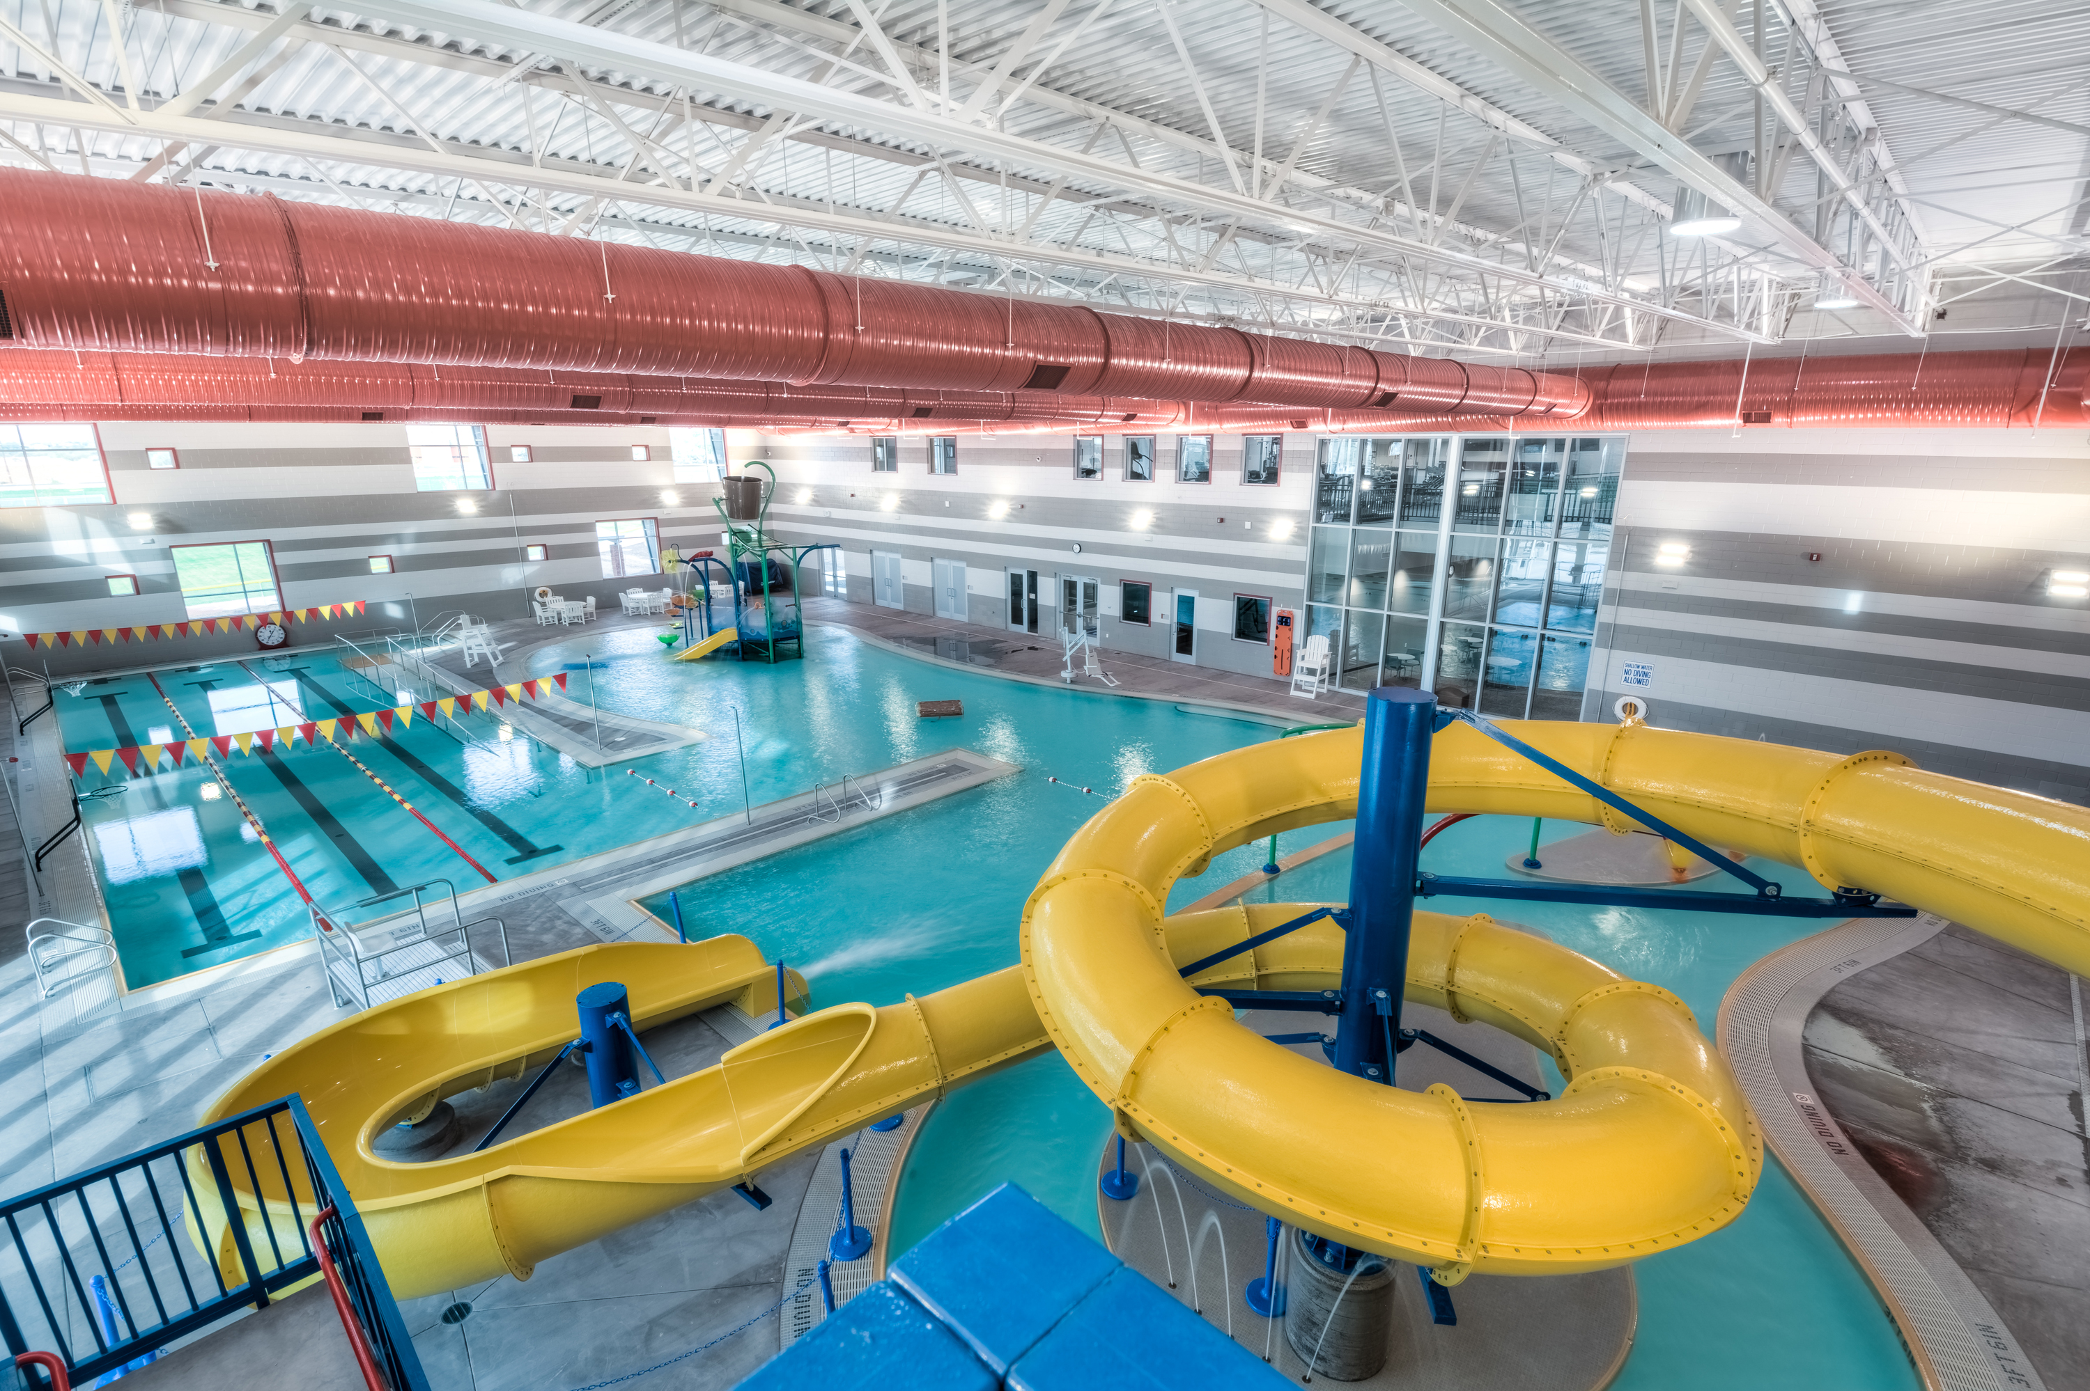
OPTION OVERVIEW
Capital Cost:
  Construction: $33,965,410 ($506 psf)
  Total Project Cost: $46,050,460
Total Size (Acres): 7 to 10 acres
Capacity: 573 (at one time)
Parking: 275 spaces
Features:
  Indoor Natatorium Spaces
    50-meter pool with two bulkheads
    1- and 3-meter springboard diving
    4,800 sq. ft. community pool
    Two (2) training pools
  Support Spaces
    Admissions
    Offices
    Locker rooms
    Spectator Seating
    Storage
    Pool mechanical
    Family changing rooms
    Food and beverage
Notes:
SAMPLE TEXT SLIDE W/ BULLETS

Slide 14
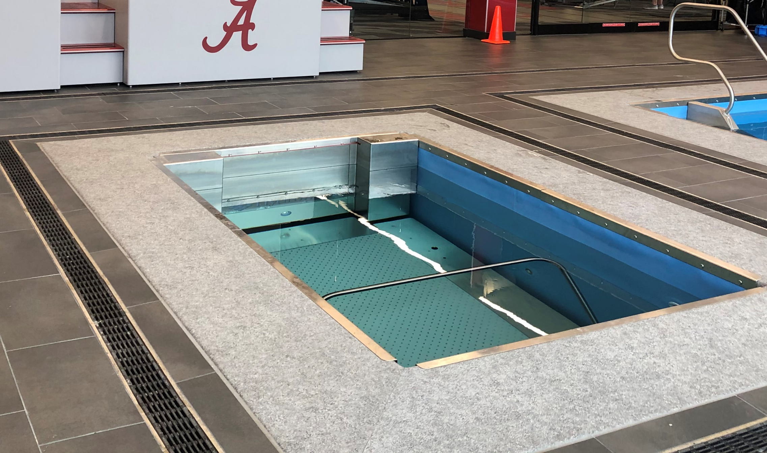
OPTION OVERVIEW
Capital Cost:
  Construction: $33,965,410 ($506 psf)
  Total Project Cost: $46,050,460
Total Size (Acres): 7 to 10 acres
Capacity: 573 (at one time)
Parking: 275 spaces
Features:
  Indoor Natatorium Spaces
    50-meter pool with two bulkheads
    1- and 3-meter springboard diving
    4,800 sq. ft. community pool
    Two (2) training pools
  Support Spaces
    Admissions
    Offices
    Locker rooms
    Spectator Seating
    Storage
    Pool mechanical
    Family changing rooms
    Food and beverage
Notes:
SAMPLE TEXT SLIDE W/ BULLETS

Slide 15
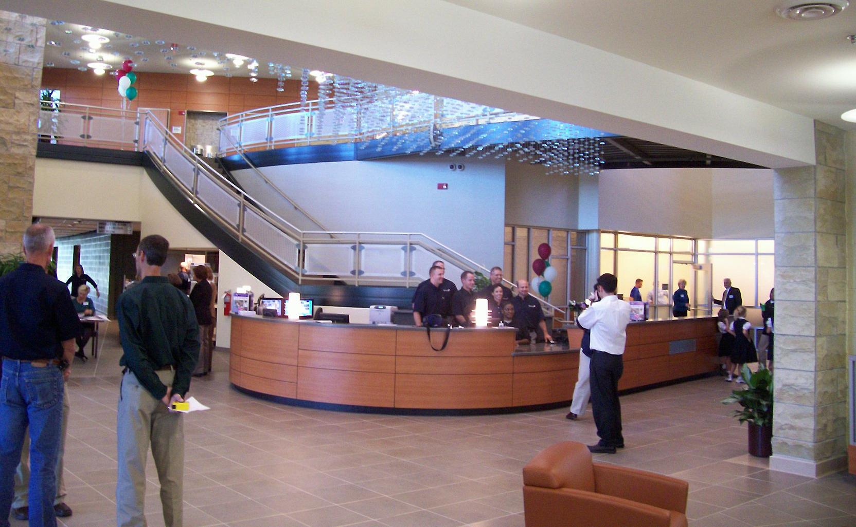
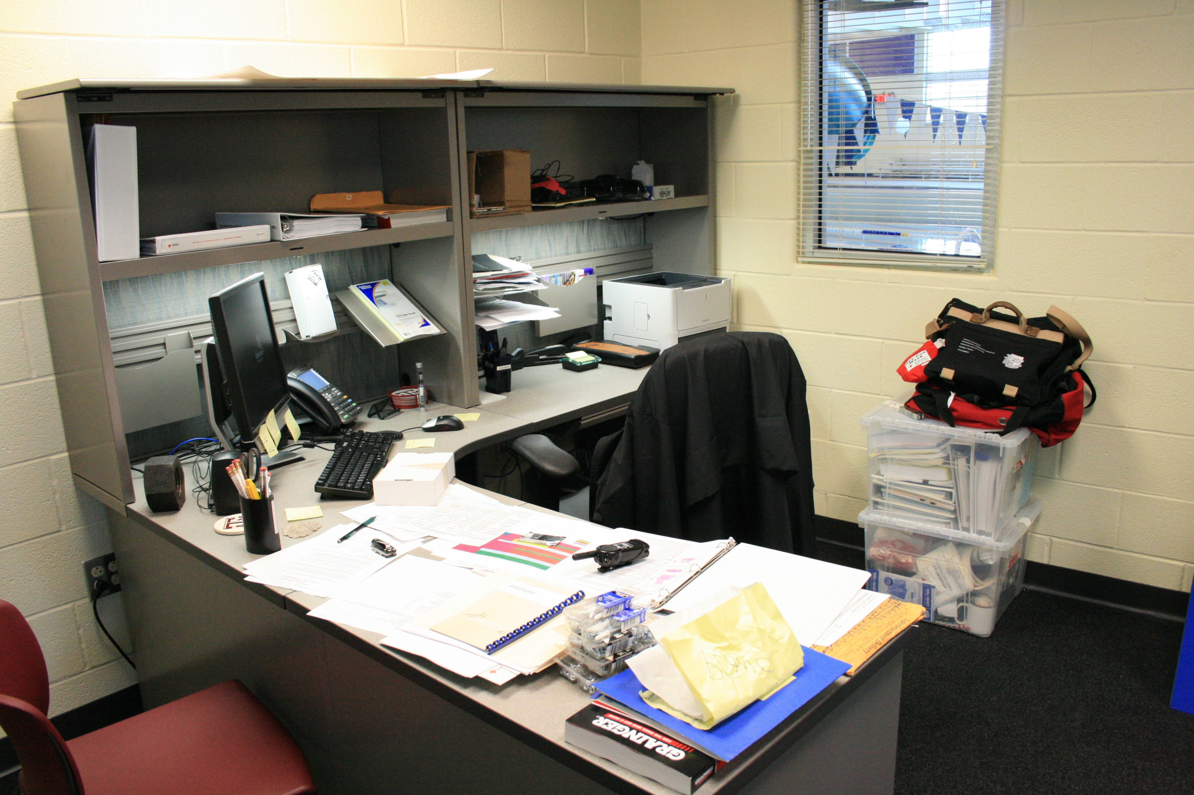
OPTION OVERVIEW
Capital Cost:
  Construction: $33,965,410 ($506 psf)
  Total Project Cost: $46,050,460
Total Size (Acres): 7 to 10 acres
Capacity: 573 (at one time)
Parking: 275 spaces
Features:
  Indoor Natatorium Spaces
    50-meter pool with two bulkheads
    1- and 3-meter springboard diving
    4,800 sq. ft. community pool
    Two (2) training pools
  Support Spaces
    Admissions
    Offices
    Locker rooms
    Spectator Seating
    Dryland Training
    Storage
    Pool mechanical
    Family changing rooms
    Food and beverage
Notes:
SAMPLE TEXT SLIDE W/ BULLETS

Slide 16
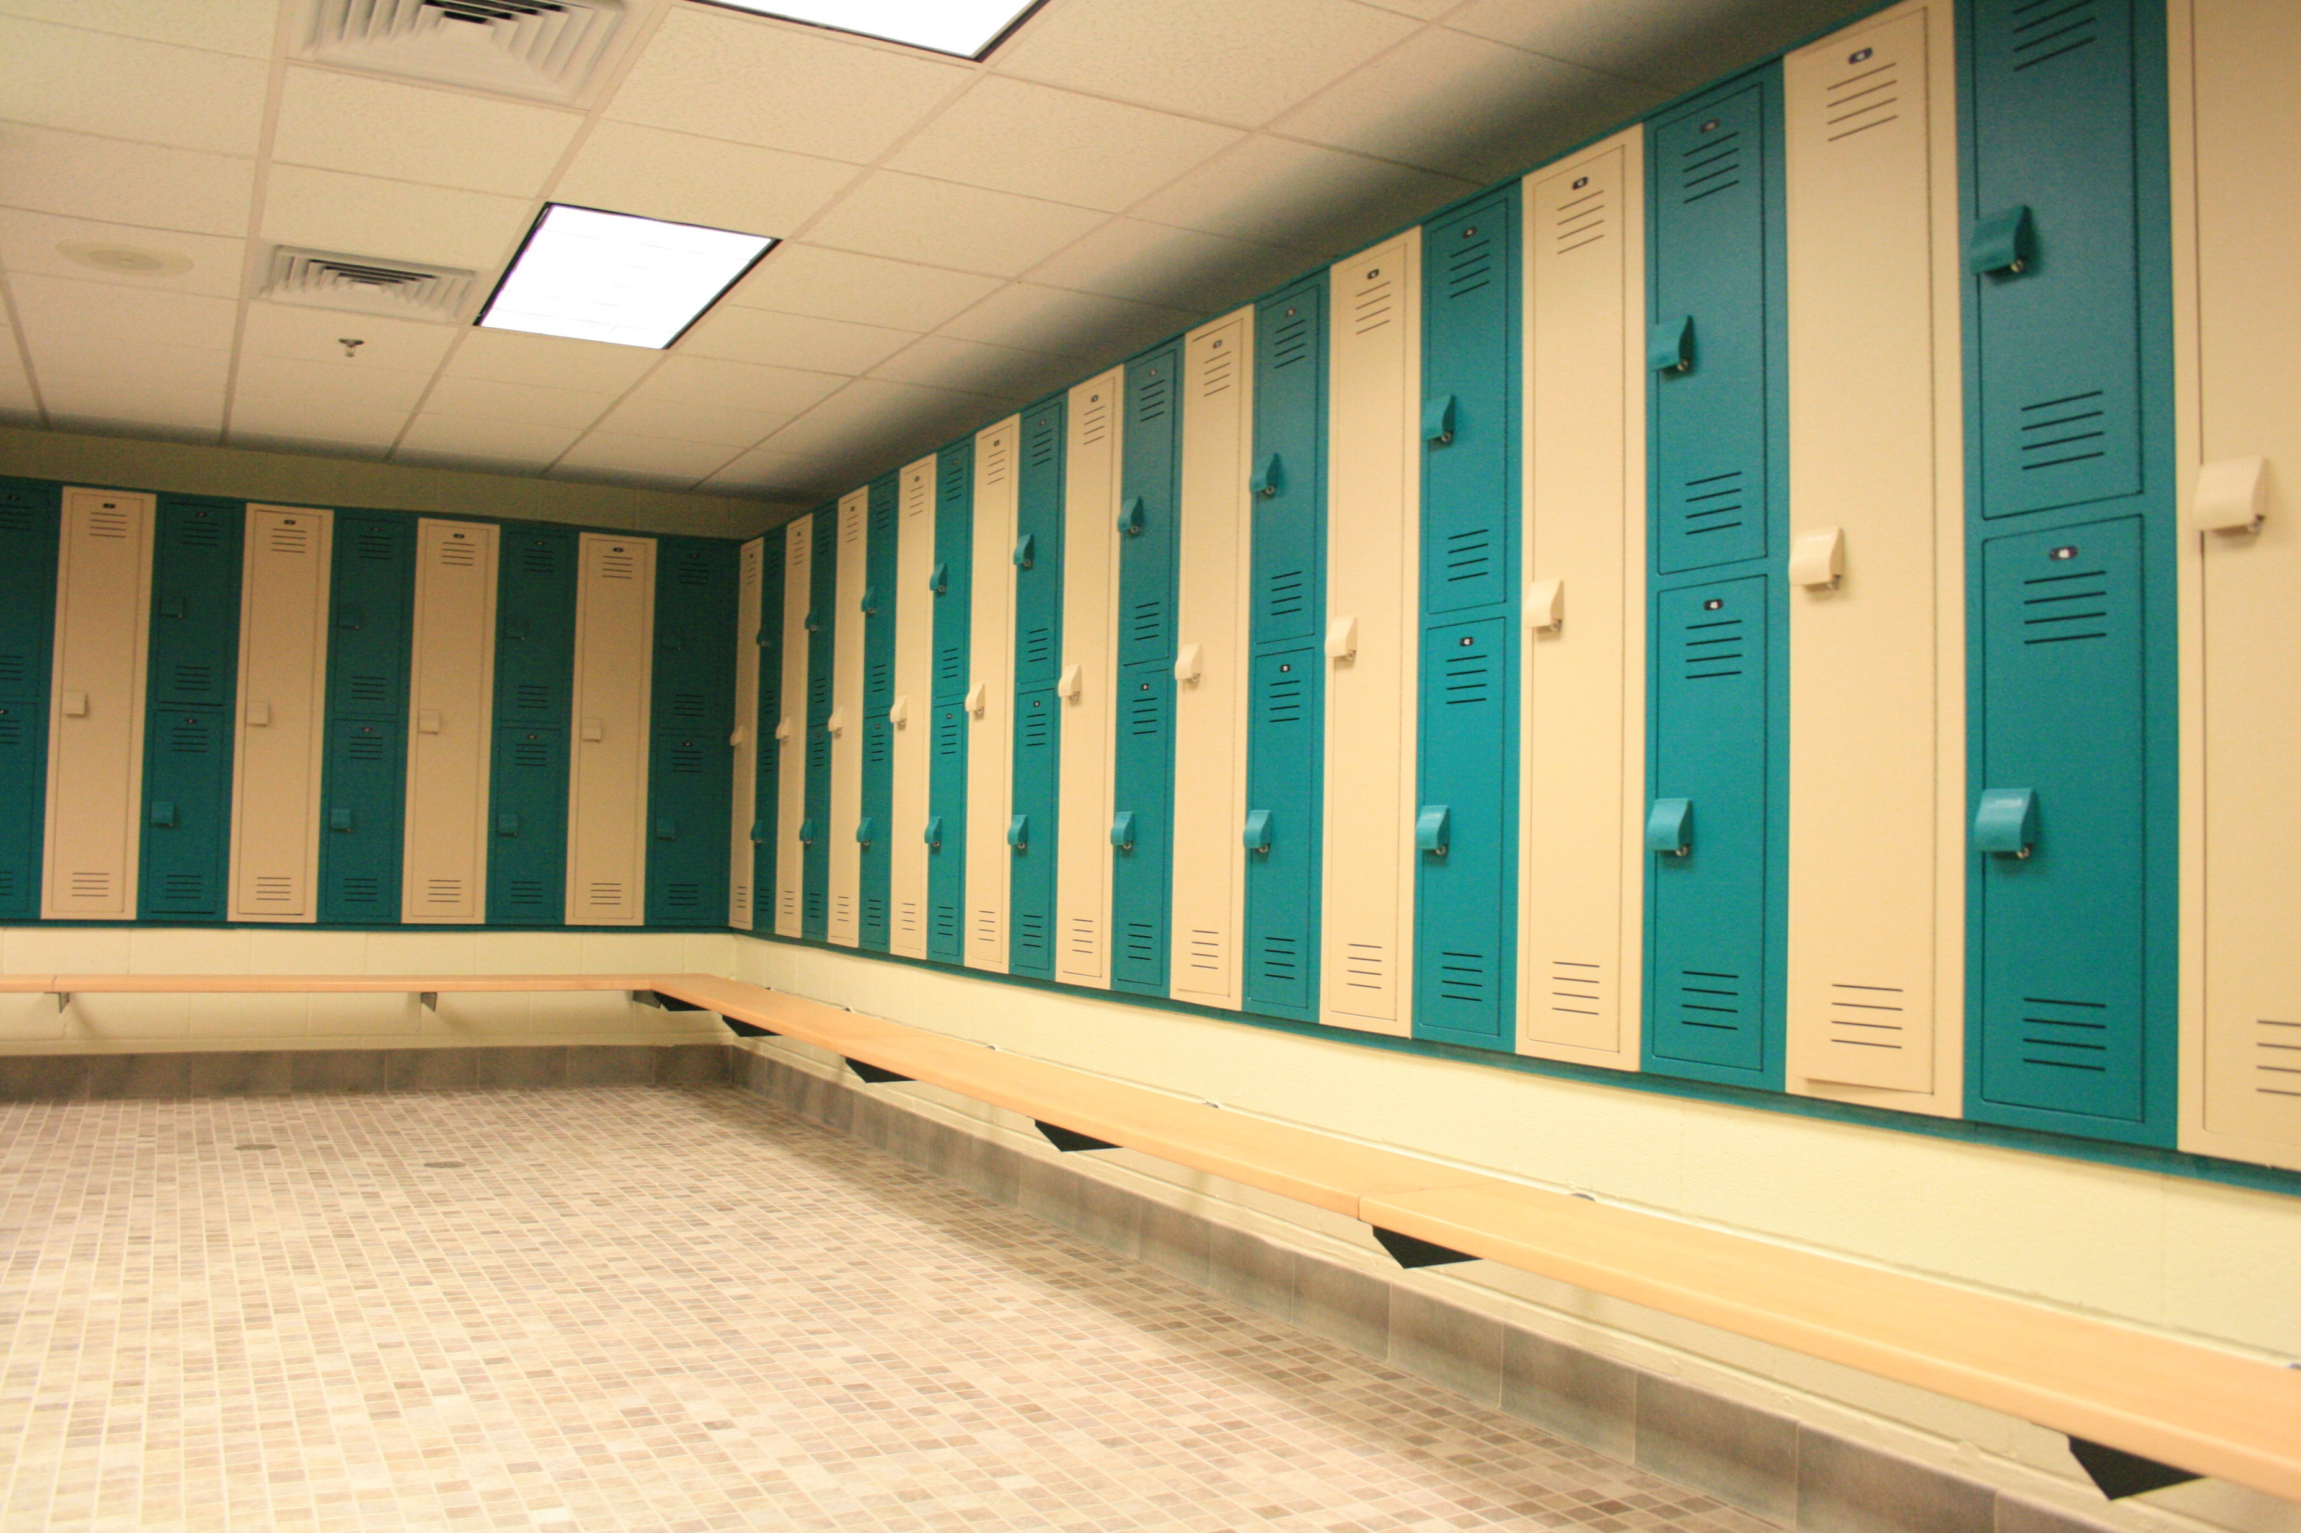
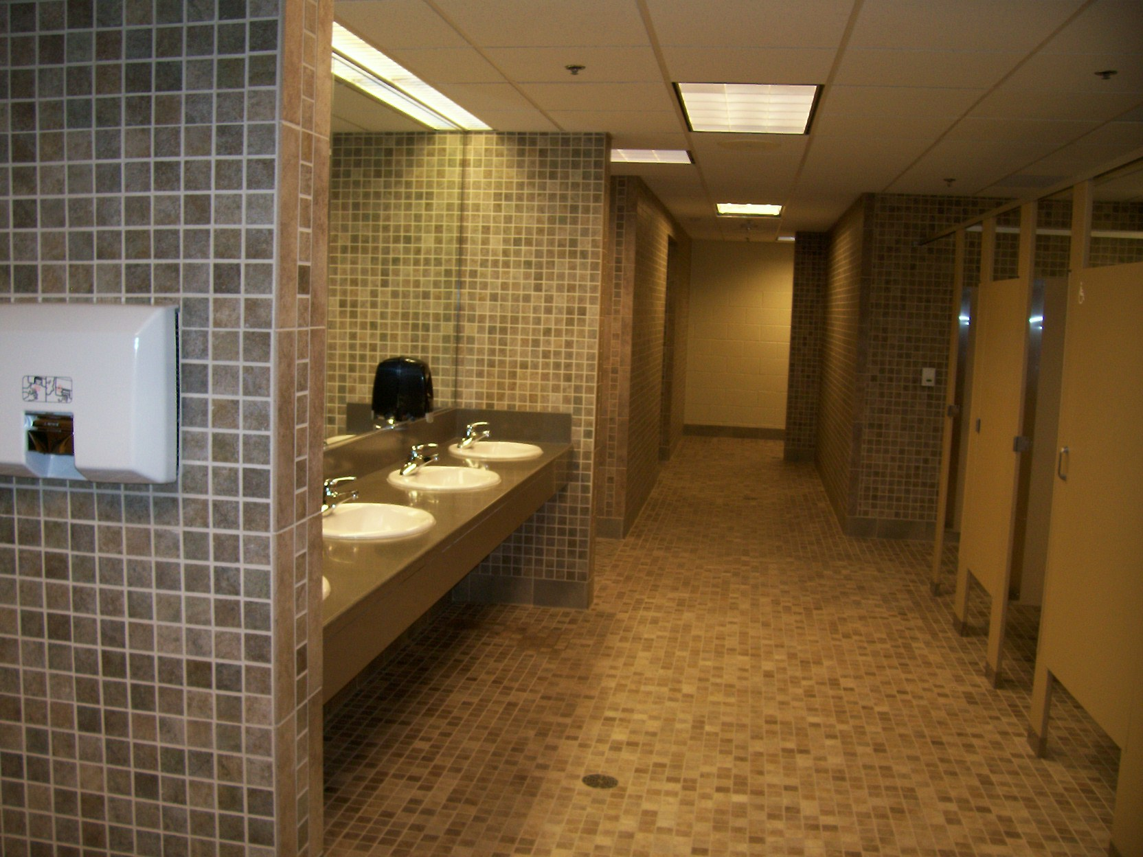
OPTION OVERVIEW
Capital Cost:
  Construction: $33,965,410 ($506 psf)
  Total Project Cost: $46,050,460
Total Size (Acres): 7 to 10 acres
Capacity: 573 (at one time)
Parking: 275 spaces
Features:
  Indoor Natatorium Spaces
    50-meter pool with two bulkheads
    1- and 3-meter springboard diving
    4,800 sq. ft. community pool
    Two (2) training pools
  Support Spaces
    Admissions
    Offices
    Locker rooms
    Spectator Seating
    Dryland Training
    Storage
    Pool mechanical
    Family changing rooms
    Food and beverage
Notes:
SAMPLE TEXT SLIDE W/ BULLETS

Slide 17
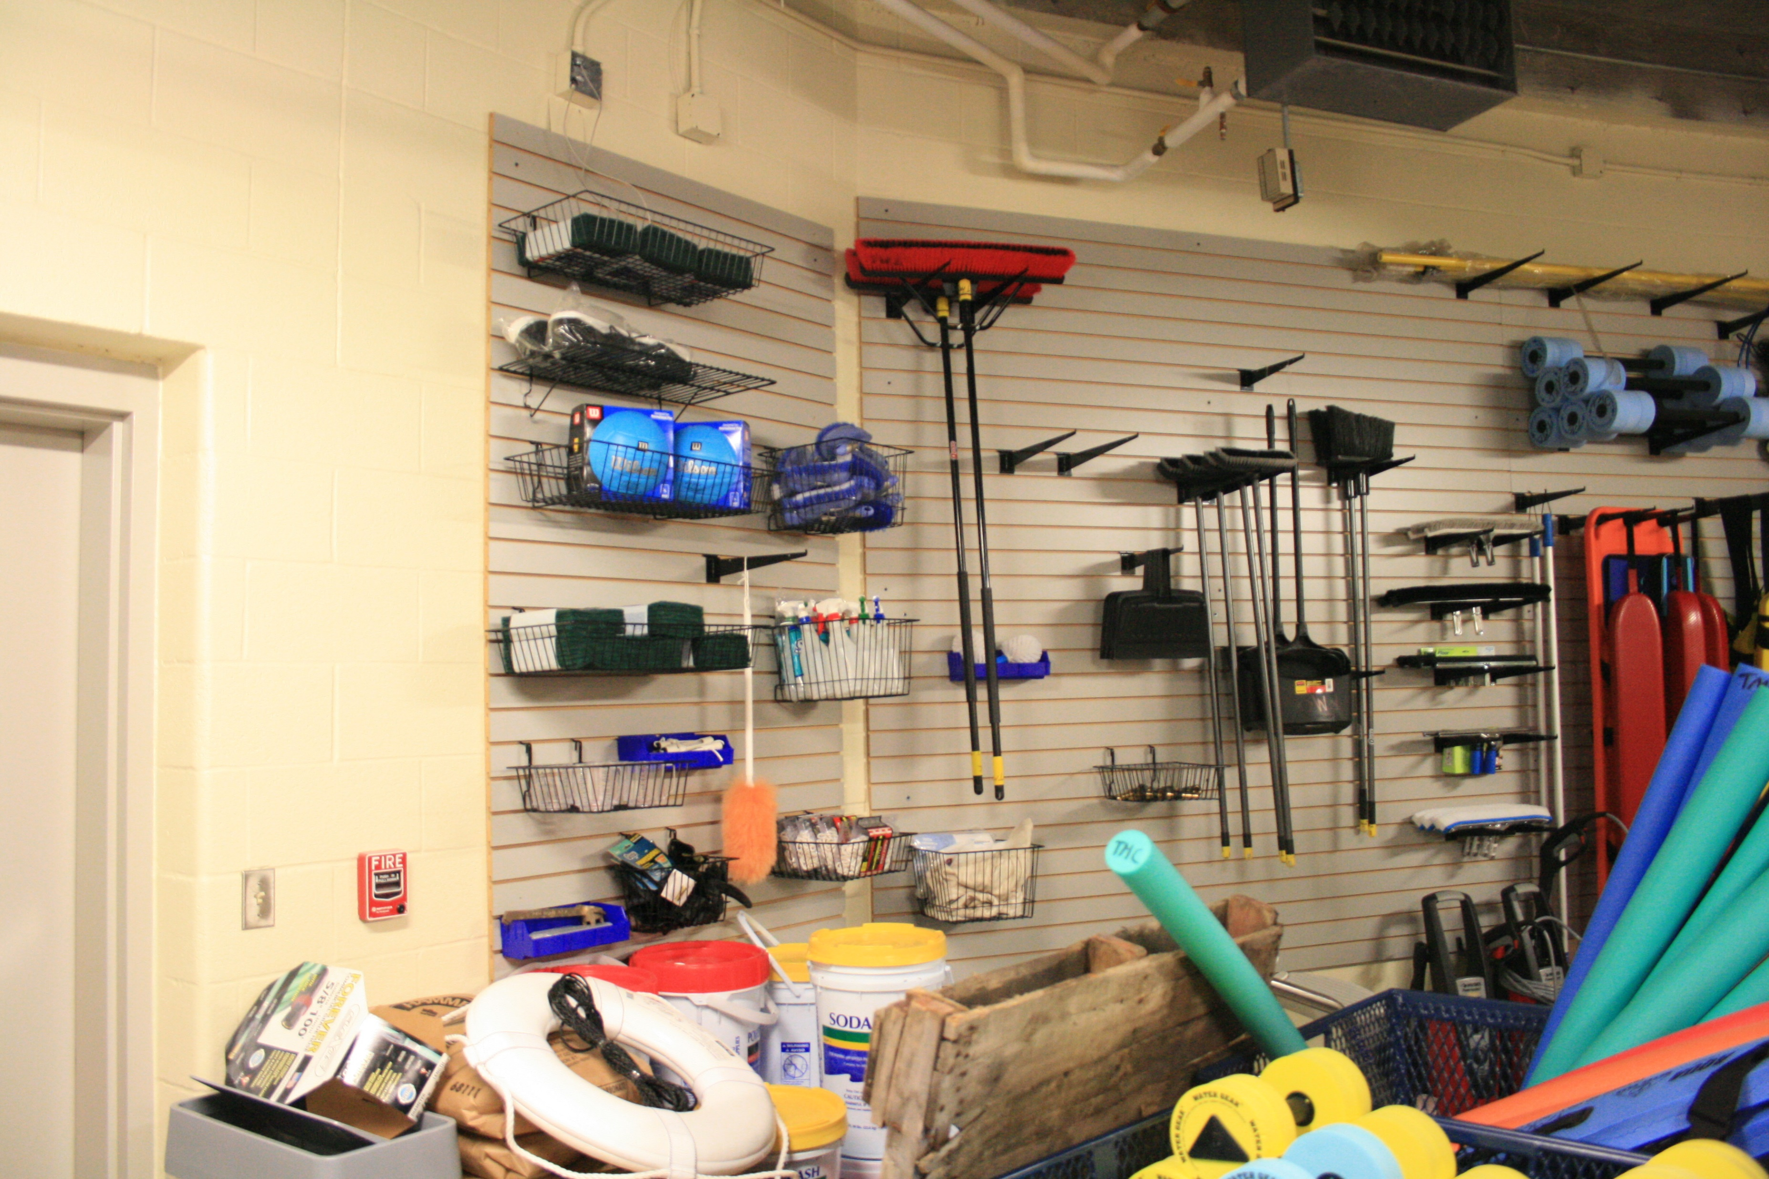
OPTION OVERVIEW
Capital Cost:
  Construction: $33,965,410 ($506 psf)
  Total Project Cost: $46,050,460
Total Size (Acres): 7 to 10 acres
Capacity: 573 (at one time)
Parking: 275 spaces
Features:
  Indoor Natatorium Spaces
    50-meter pool with two bulkheads
    1- and 3-meter springboard diving
    4,800 sq. ft. community pool
    Two (2) training pools
  Support Spaces
    Admissions
    Offices
    Locker rooms
    Spectator Seating
    Dryland Training
    Storage
    Pool mechanical
    Family changing rooms
    Food and beverage
Notes:
SAMPLE TEXT SLIDE W/ BULLETS

Slide 18
OPERATIONAL ANALYSIS
The expense analysis includes a detailed budget model for estimating probable expenses for major areas of labor, contractual services, commodities, and utilities. User projections are made based on programming. Expenses are estimated taking into account hours of operation, attendance projections, local weather patterns, local utility rates, and other key items. The study used $0.16 per KWH, $3.46 per 1,000 gallons of water, $1.17 per therm and $1.85 per gallon/pound of chlorine to generate projected expenses for the swimming pool.
Any facility and program schedule will require flexibility to adapt to specific needs of the community, including both daily and season pass users, as well as those signing up for programs. Expenses for these programs are calculated based on a percentage of the total revenue. It is the responsibility of the facility supervisor to monitor user group demands and adjust schedules accordingly. Revenue projections are based on marketing programming that would include Season / Annual Passes, Daily Admissions, Birthday Parties, Lifeguard Courses and Food and Beverage.
Notes:
SAMPLE TEXT SLIDE W/ BULLETS

Slide 19
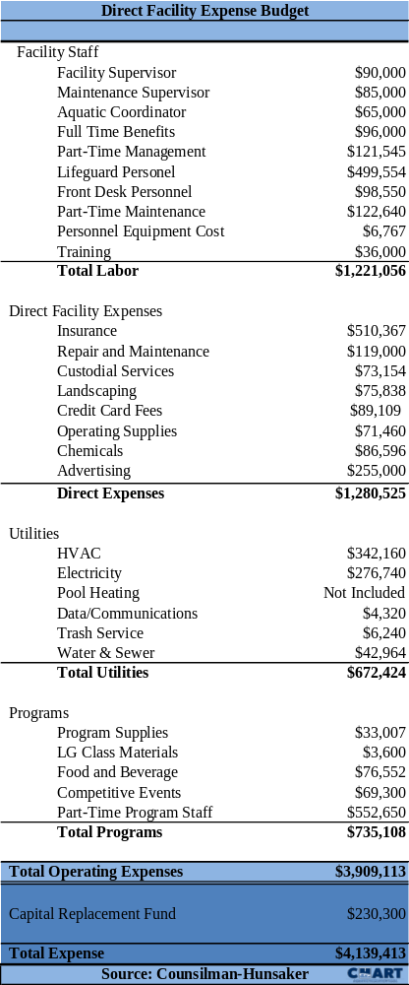
FACILITY EXPENSE BUDGET
Notes:
SAMPLE TEXT SLIDE W/ BULLETS

Slide 20
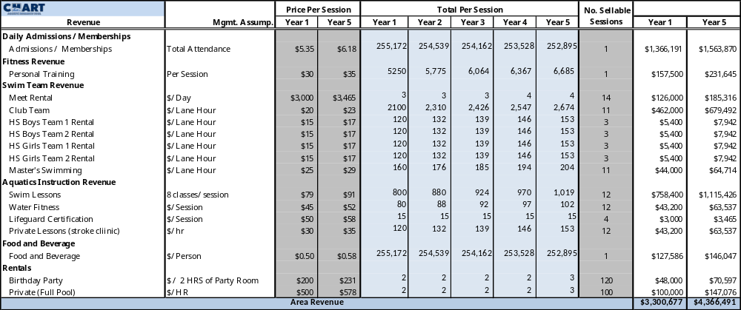
FACILITY REVENUE BUDGET
Notes:
SAMPLE TEXT SLIDE W/ BULLETS

Slide 21
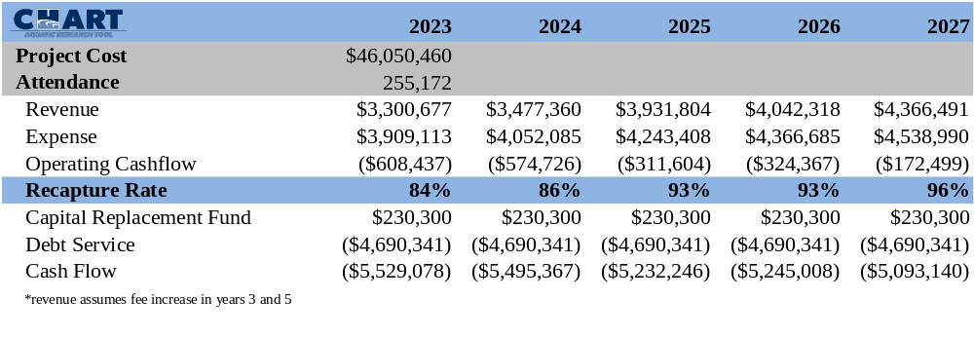
Summery
Notes:
SAMPLE TEXT SLIDE W/ BULLETS

