Slide 1

Aquatic Feasibility Study Survey
October 2023

Slide 2

Who Answered the Survey
677 Responses

Slide 3
Q2: What is your age group?

Slide 4
Q2: What is your age group?
Answered: 676 Skipped: 1
ANSWER CHOICES | RESPONSES
Under 18 years old | 0.89% | 6
18-35 years old | 31.95% | 216
36-55 years old | 52.96% | 358
56 years old and above | 14.20% | 96
TOTAL |  | 676

Slide 5
Q3: What is the age demographic in your household? (Select all that apply)

Slide 6
Q3: What is the age demographic in your household? (Select all that apply)
Answered: 674 Skipped: 3
ANSWER CHOICES | RESPONSES
Children 0-5 years | 33.68% | 227
Children 6-12 years | 38.72% | 261
13-18 years | 28.04% | 189
18-35 years | 36.65% | 247
35-60 years | 50.59% | 341
60+ years | 13.65% | 92
TOTAL |  | 1357

Slide 7
Q4: How often do you or your family visit aquatic facilities in the summer?

Slide 8
Q4: How often do you or your family visit aquatic facilities in the summer?
Answered: 674 Skipped: 3
ANSWER CHOICES | RESPONSES
Multiple times a week | 28.04% | 189
Once a week | 19.58% | 132
A few times a month | 28.93% | 195
Rarely or never | 23.44% | 158
TOTAL |  | 674

Slide 9
Q5: How often do you or your family visit aquatic facilities in the winter?

Slide 10
Q5: How often do you or your family visit aquatic facilities in the winter?
Answered: 670 Skipped: 7
ANSWER CHOICES | RESPONSES
Multiple times a week | 10.0% | 67
Once a week | 9.70% | 65
A few times a month | 30.15% | 202
Rarely or never | 50.15% | 336
TOTAL |  | 670

Slide 11
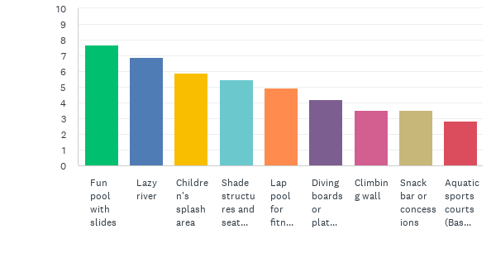
Q6: What types of amenities and features would you like to see in a new outdoor aquatic center?

Slide 12
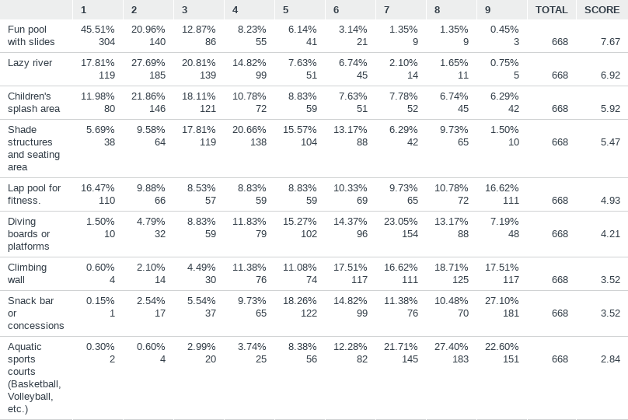
Q6: What types of amenities and features would you like to see in a new outdoor aquatic center?
Answered: 668 Skipped: 9

Slide 13
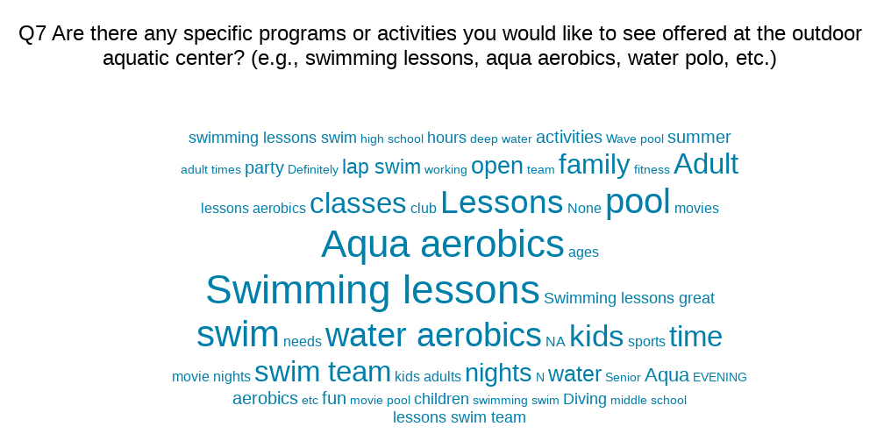

Slide 14
Q8: Would you be interested in having dedicated areas or times for specific user groups (e.g., adult-only hours, family hours, senior citizen hours, etc.) at the outdoor aquatic center?

Slide 15
Q8: Would you be interested in having dedicated areas or times for specific user groups (e.g., adult-only hours, family hours, senior citizen hours, etc.) at the outdoor aquatic center?
Answered: 667 Skipped: 10
ANSWER CHOICES | RESPONSES
Yes, I would be interested. | 48.28% | 322
No, I prefer open access for all user groups. | 32.98% | 220
Not sure/No preference | 18.74% | 125
TOTAL |  | 667

Slide 16
Q9: How would you prefer to fund the construction of the pool?

Slide 17
Q9: How would you prefer to fund the construction of the pool?
Answered: 673 Skipped: 4
ANSWER CHOICES | RESPONSES
Sales tax increase – this would provide dedicated funding that comes from everyone who shops in Johnstown - residents and visitors alike. | 17.38% | 117
Property tax increase – this would provide dedicated funding that comes from Johnstown residents only. | 1.04% | 7
Donations and fundraising | 14.41% | 97
Corporate sponsorships | 12.04% | 81
Combination of the above | 46.51% | 313
Other (please specify) | 8.62% | 58
TOTAL |  | 673

Slide 18
Q10: How would you prefer the outdoor aquatic center's operations and maintenance to be funded?

Slide 19
Q10: How would you prefer the outdoor aquatic center's operations and maintenance to be funded?
Answered: 671 Skipped: 6
ANSWER CHOICES | RESPONSES
User fees/memberships | 31.15% | 209
Tax revenues | 5.37% | 36
Donations and fundraising | 5.51% | 37
Corporate sponsorships | 6.71% | 45
Combination of the above | 46.65% | 313
Other (please specify) | 4.62% | 31
TOTAL |  | 671

Slide 20
Q11: How far would you be willing to travel to access the outdoor aquatic center?

Slide 21
Q11: How far would you be willing to travel to access the outdoor aquatic center?
ANSWER CHOICES | RESPONSES
Within walking distance | 5.95% | 39
Within 5 miles | 45.73% | 300
Within 10 miles | 33.69% | 221
I would be willing to travel longer distances for specific features or amenities | 14.63% | 96
TOTAL |  | 656

Slide 22
Q12: How likely are you to recommend the outdoor aquatic center to others in the community?

Slide 23
Q12: How likely are you to recommend the outdoor aquatic center to others in the community?
Answered: 673 Skipped: 4
ANSWER CHOICES | RESPONSES
Very likely | 64.49% | 434
Likely | 18.28% | 123
Neutral/Not sure | 12.18% | 82
Unlikely | 0.59% | 4
Very unlikely | 4.46% | 30
TOTAL |  | 673

