Slide 1
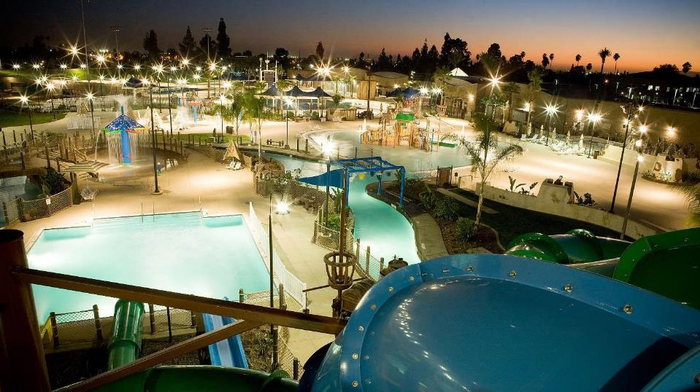

Notes:
Most people start their presentations by explaining what they do. Today we want to tell you what we believe. > We believe that people of …

Slide 2




AQUATIC USER GROUPS
Recreation
Competition
Instruction
Wellness & Therapy
Notes:
When discussing aquatic centers we need to talk about the 4 user groups.
Each of their needs are tied to Temp, Access and Depth.

Slide 3
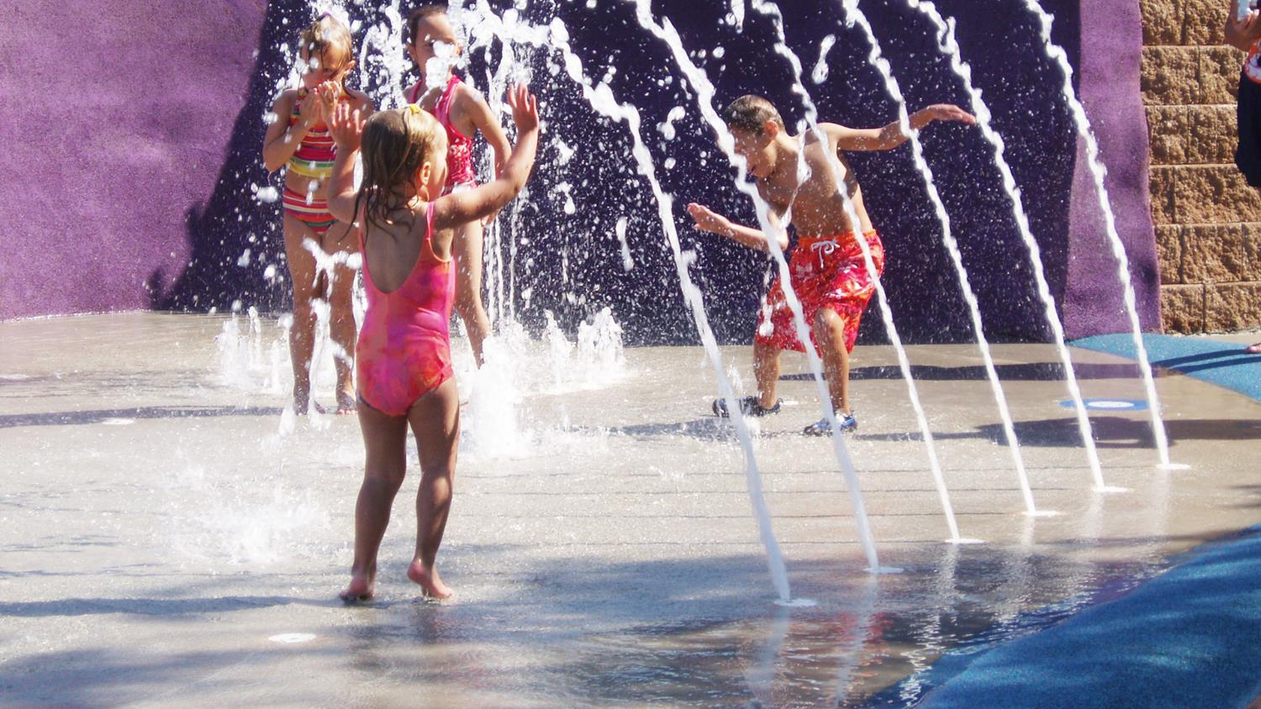
Aquatics can transform us
Notes:
An aquatics facility ideally becomes living thing. We believe every design decision — from conception to the details of daily operation — plays a role in serving the human experiences. And every facility that is designed, built and operated to serve the human experience improves its community, and then, the world.

Slide 4
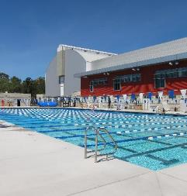
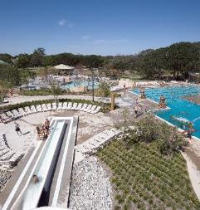
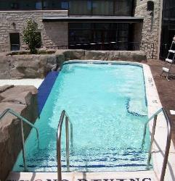
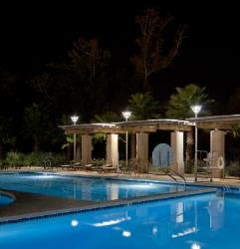
Identifying Your Key Aquatic Users
Competition
Recreation
Instructional
Wellness and Therapy

Slide 5
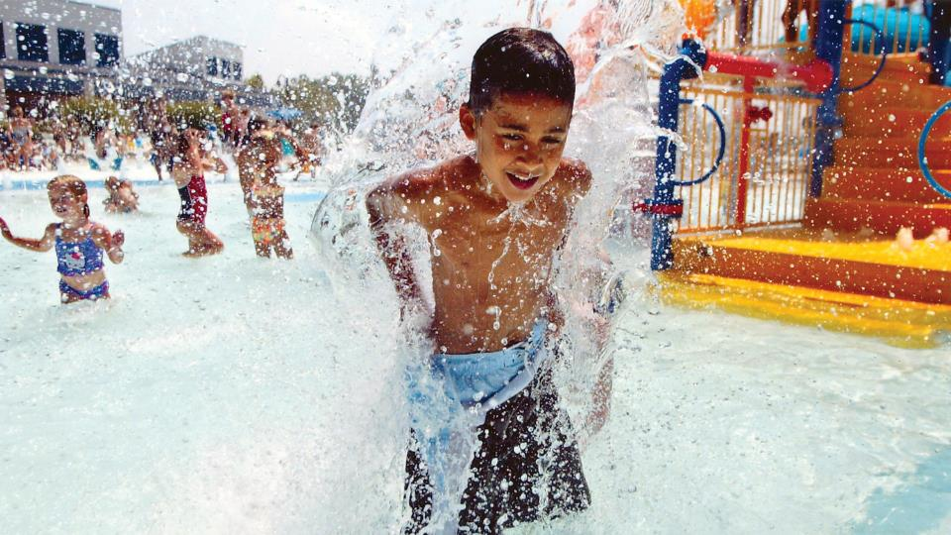
community
Notes:
Brilliantly designed public aquatic facilities > primary and higher education …

Slide 6
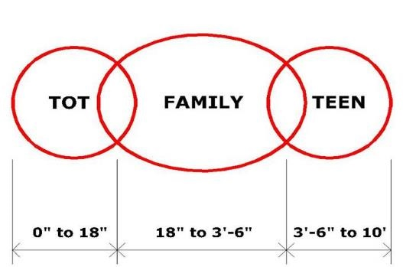
Public Sector Aquatics…Where we are
Times they are a changing…
  1950’s to 1980’s pools have become functionally and financially obsolete
  Focus on families - not competition and kids
  Pay for play
The modern outdoor pool…
  Tot areas
  Family areas
  Teen areas
  Learn to swim
  Spray / Play Areas
Pool Relationship Diagram

Slide 7
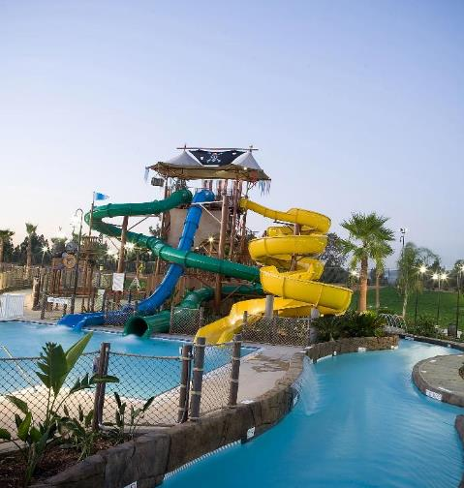
Aquatic User Expectations
Multiple programming opportunities
Entertainment value
Extreme features
Increased customer service
Vision and expectations vary amongst age groups
Notes:
And we understand that every use will have a different expectation and vision of what an aquatic facility should be and how this can impact their own personal experiences.

Slide 8
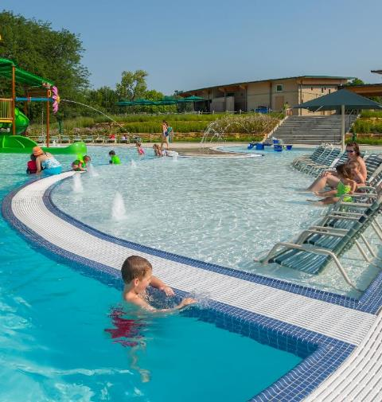
Define the Community Expectations
Opportunity Driven
  Every child learn to swim
  Provide an opportunity for community aquatic recreation to all residents
Economic Driven
  Revenue generation
  Increase in property values
  Business partnership opportunities
Notes:
It not just defining individual expectations, but importantly how can we identify and meet the needs of the entire community who might be using your facility?

Slide 9
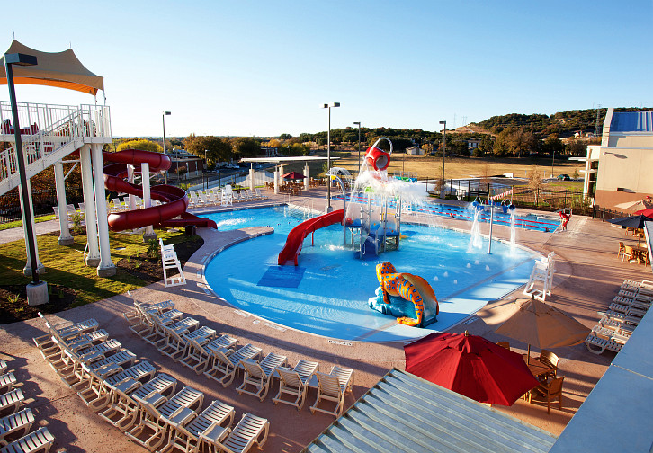
VISION AND EXPECTATIONS
child’s Vision

Slide 10
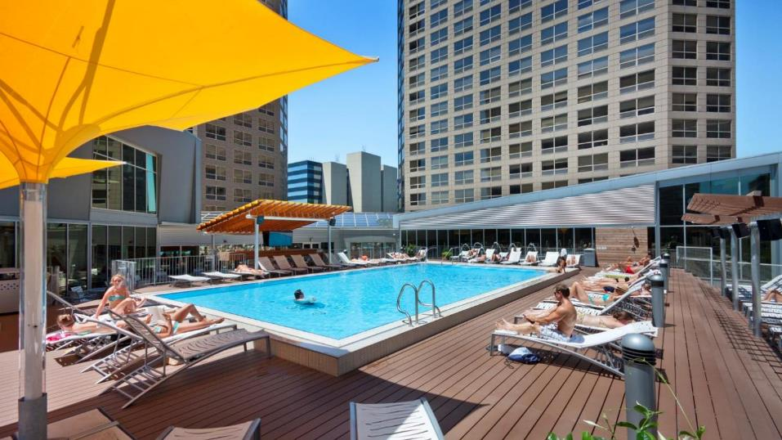
VISION and EXPECTATIONS
Adult’s Vision

Slide 11
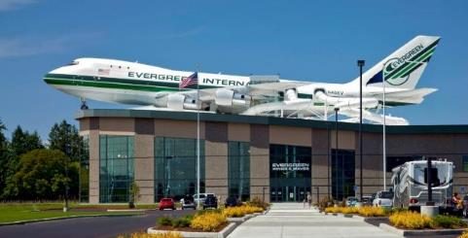
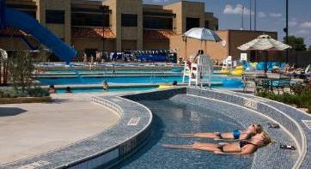
Creating an Experience
Prioritize Aquatic Users Needs
Zoning
  Age/User Groups
  Active and Passive Spaces
Image/Aesthetics/Finishes
Theming
Creative Design Process

Slide 12
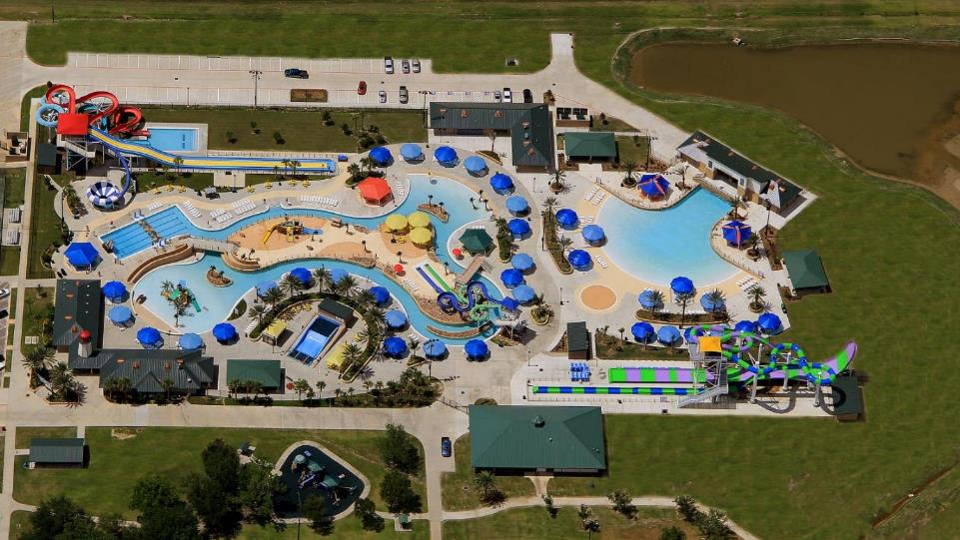
Recreation users

Slide 13
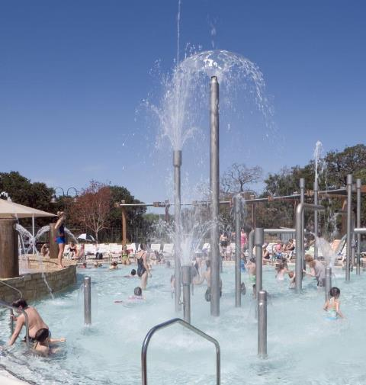
Recreation User Program Needs
Age Specific Opportunities
Varying Water Depth Requirements
Combination of Active and Passive Water
Maximizing Open Water Spaces

Slide 14
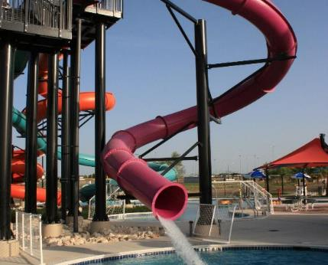
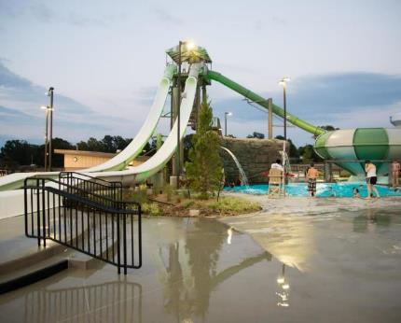
Waterslides

Slide 15
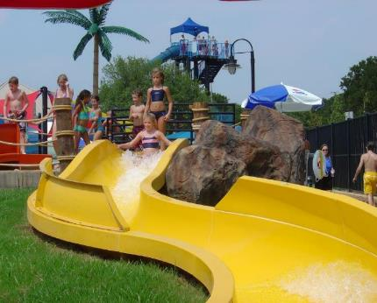
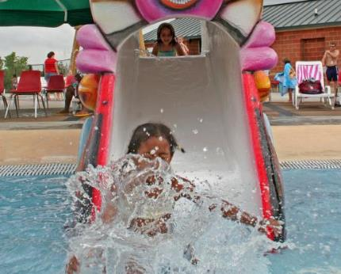
Kiddie Waterslides

Slide 16
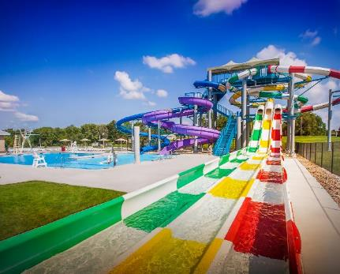
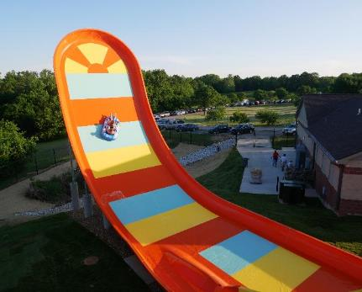
Extreme Slides

Slide 17
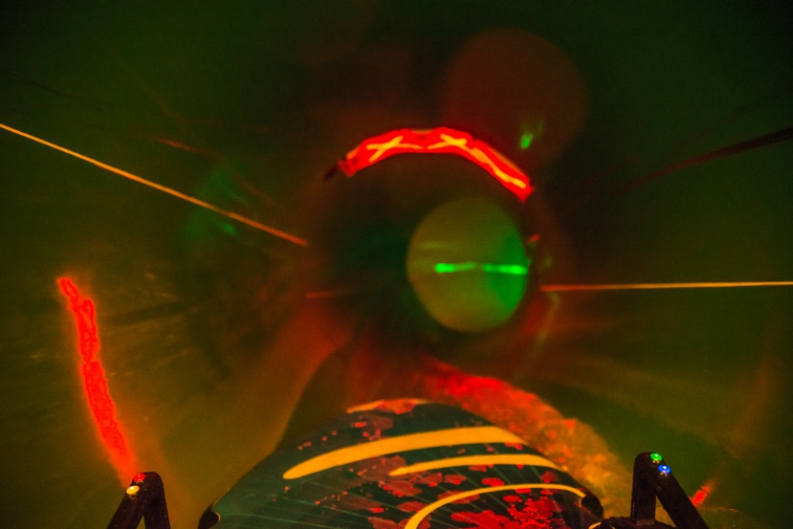
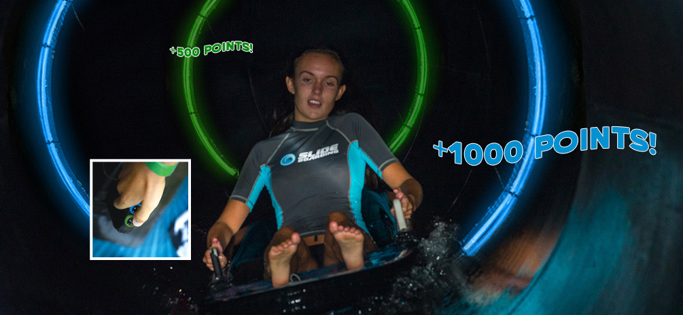
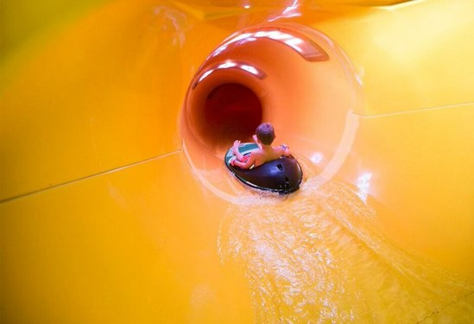
SLIDEBOARDING
  Waterslide and Video Game combined
  Additional revenue generation
  Draws in teen population
  Allows you to capture their information
  Impromptu tournaments on low attendance days

Slide 18
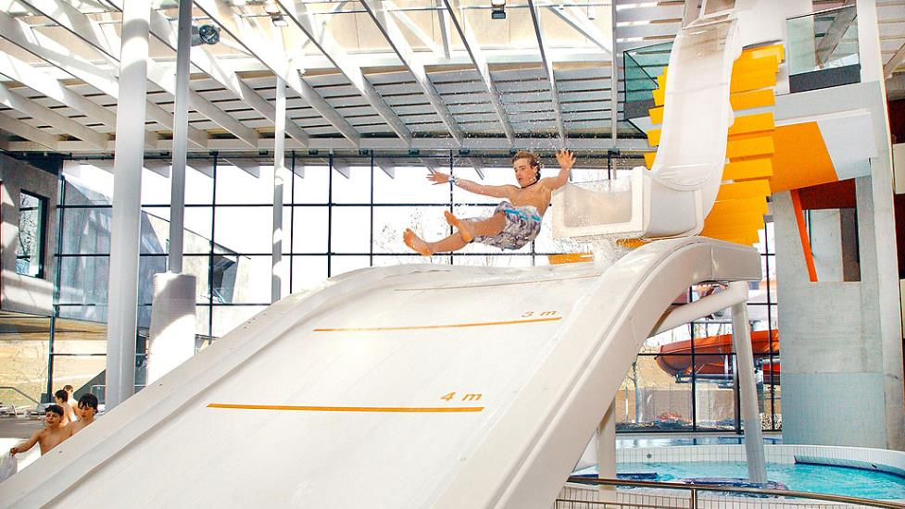
High Fly Slide
  Simulates “ski-jumping” sensation
  Unique attraction
  Padding landing zone
  Distance measurements

Slide 19
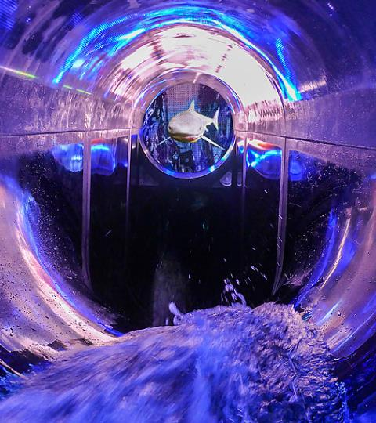
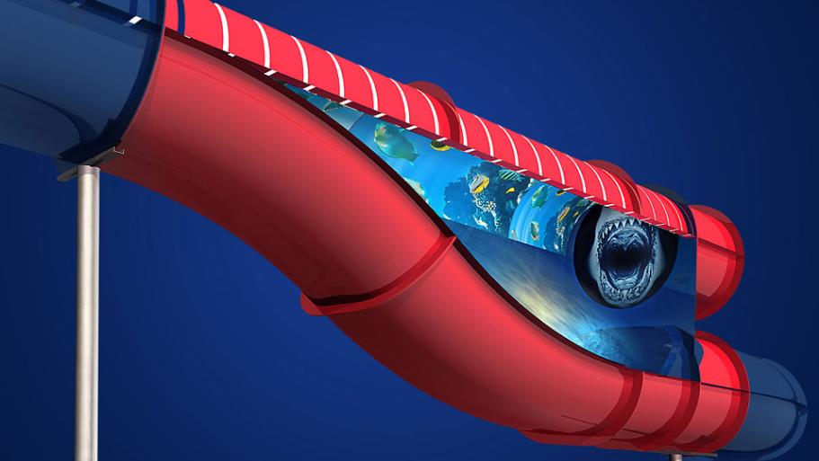
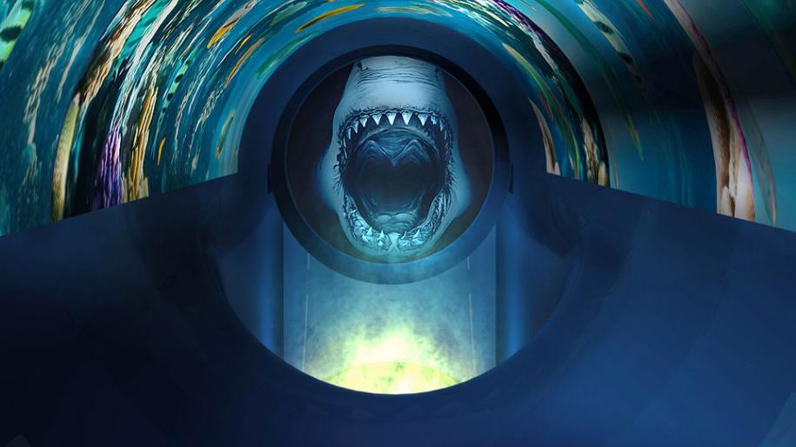
Infinity Jump Slide
  Enhanced visual experience and physical experience.
  An add-on component to traditional tube slides
  Mid-flight trap door, integrating a jump ramp with a hidden drop slope

Slide 20
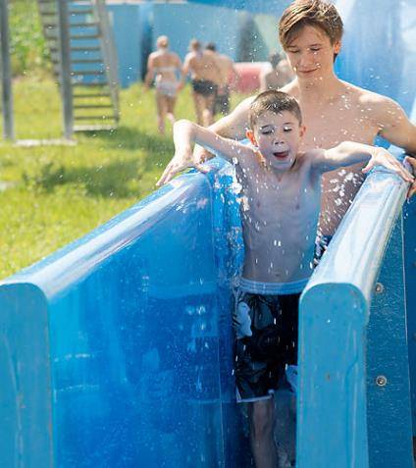
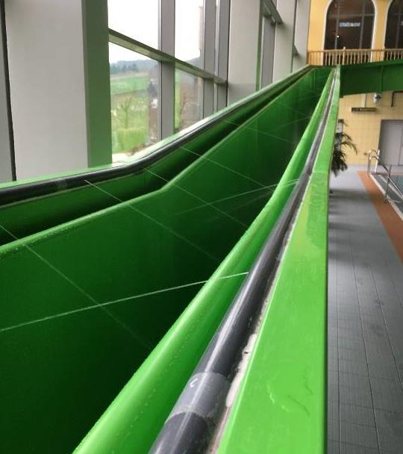
Freestyle Standup Slide
  First ever stand-up waterslide
  Slides is tapered to reduce falls
  Handrails are “wetted surface”
  Less slope compared to traditional tube slides to reduce speed

Slide 21

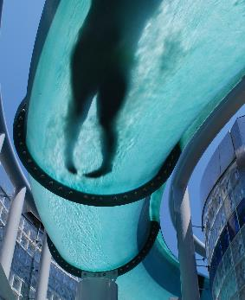
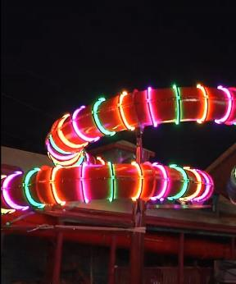
Waterslide Flume Finishes
  Translucent Band
  Translucent Section
  LED Hoop Lighting

Slide 22
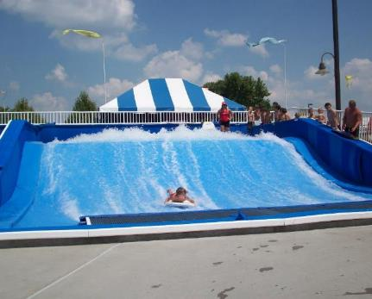
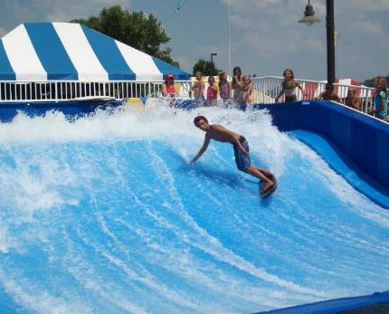
Flowrider

Slide 23
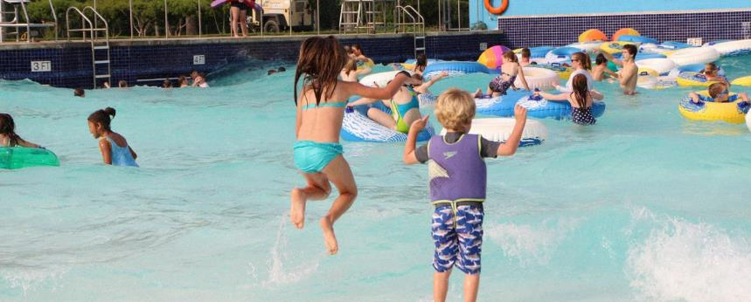
Wave Technology

Slide 24
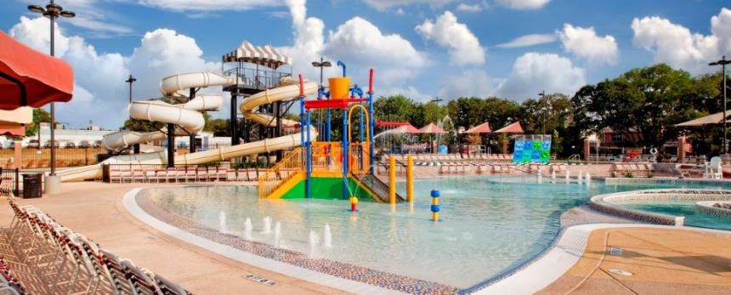
Zero Depth Entry

Slide 25
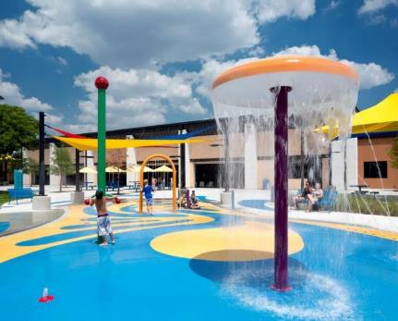
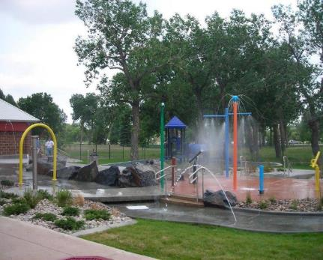
Vertical Water Sprays

Slide 26
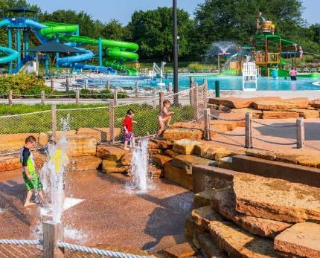
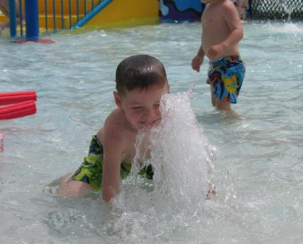
Ground Spray Features

Slide 27
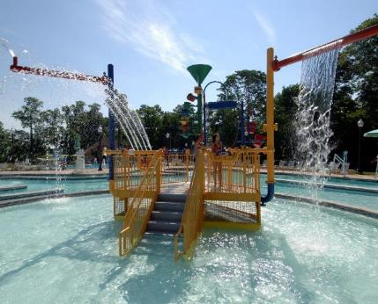
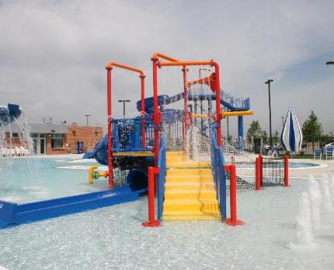
Small Play Feature

Slide 28
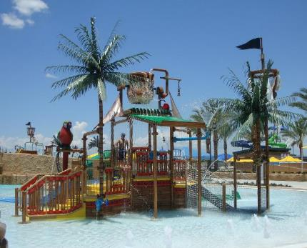
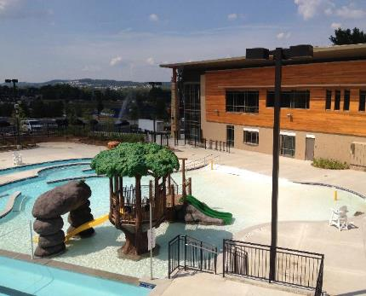
Large Play Feature

Slide 29
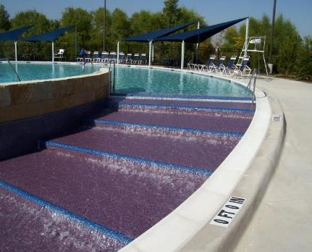
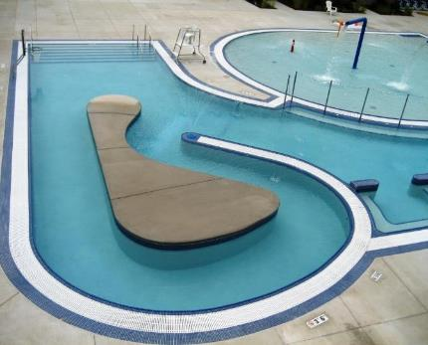
Shallow Step Entry

Slide 30
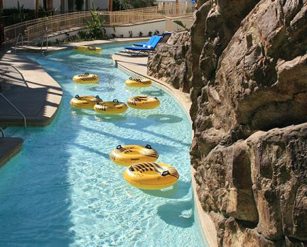
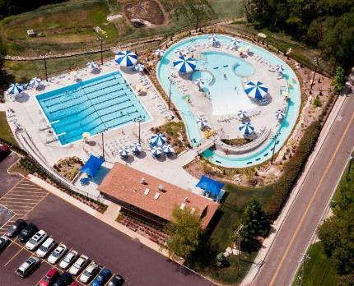
Lazy River

Slide 31
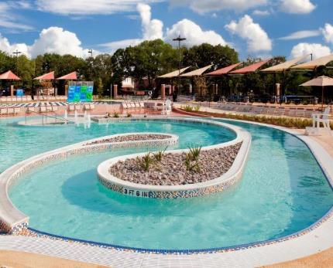

Current Channel

Slide 32


Vortex

Slide 33


Lily Pad Walk

Slide 34


Water Floatables

Slide 35


NinjaCross
  Based on the popular Ninja TV show
  Ability to retrofit to almost any space
  Adds fun amenity to flat water areas
  Easily moved for programming
  Non-swimmer attendance
  Special event revenue

Slide 36


Aquaninja

Slide 37


Wet Deck

Slide 38


Aquazip’n

Slide 39





Maximize Open WATER SPACES

Slide 40


Water Basketball

Slide 41


Water Volleyball

Slide 42


Climbing Wall

Slide 43


Rock Climbing Wall

Slide 44


Wibit

Slide 45



Recreational Diving

Slide 46
Notes:
Most people start their presentations by explaining what they do. Today we want to tell you what we believe. > We believe that people of …

